Slide 1
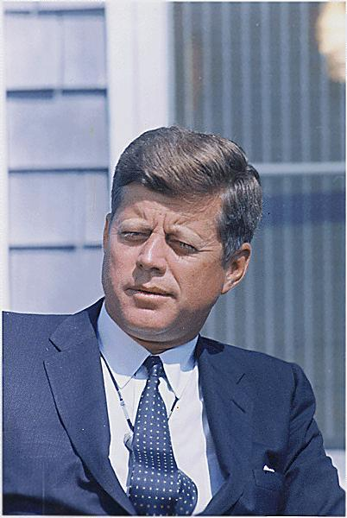
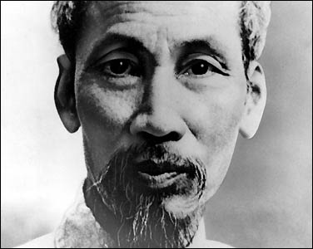
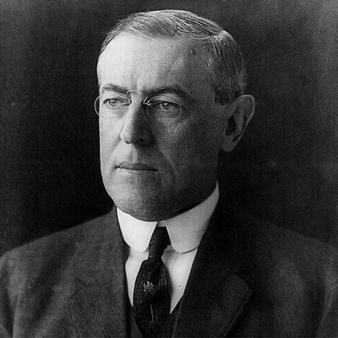
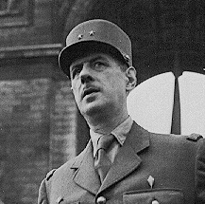
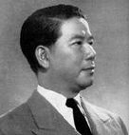
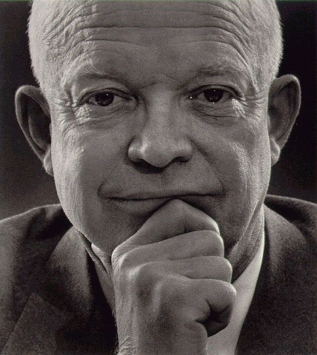
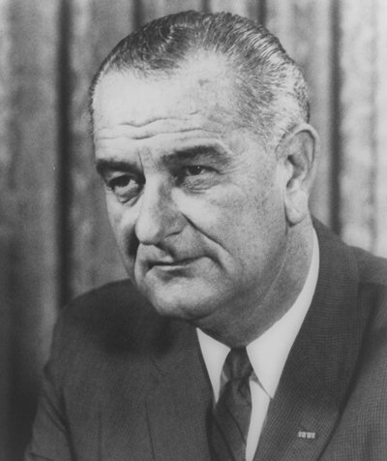
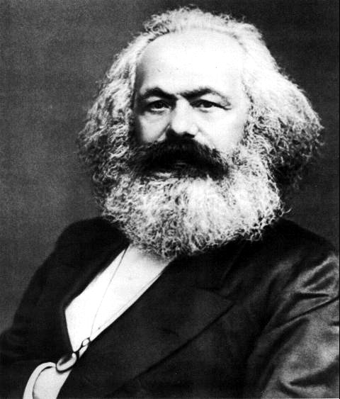
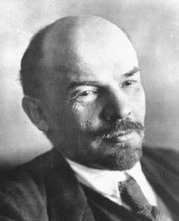
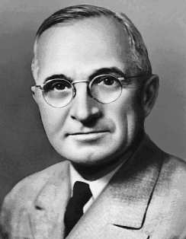
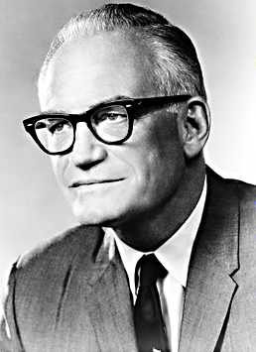
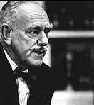
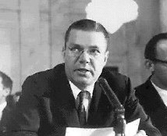
Vietnam: Road to “The American War”

Slide 2
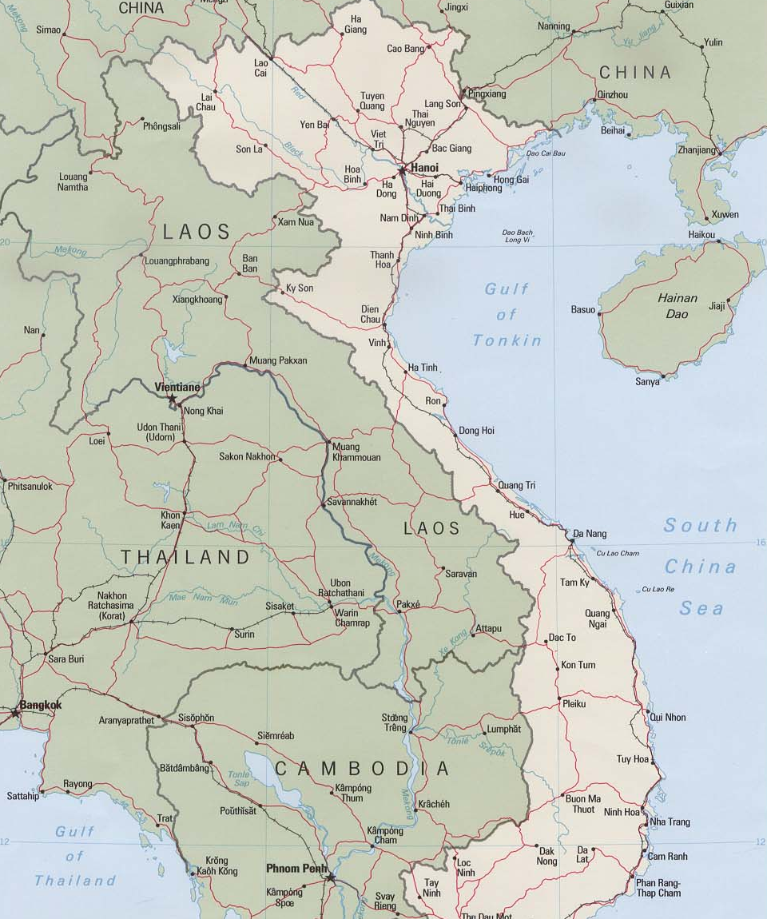
“It was patriotism, not Communism, that inspired me.”
Ho Chi Minh

Slide 3
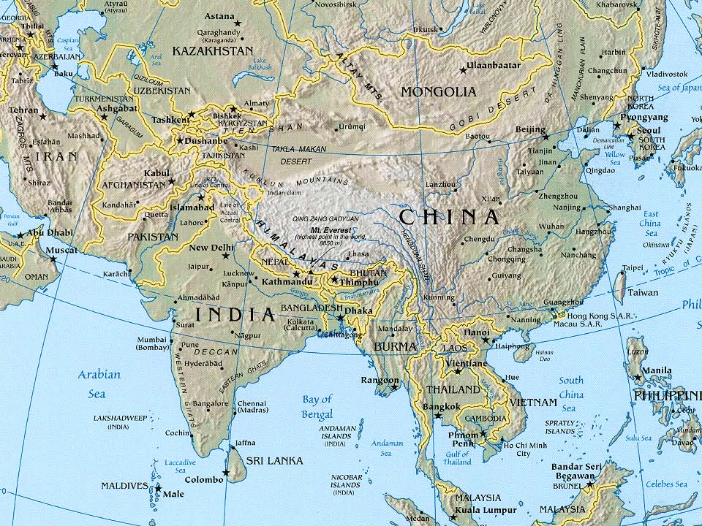
Southeast Asia

Slide 4
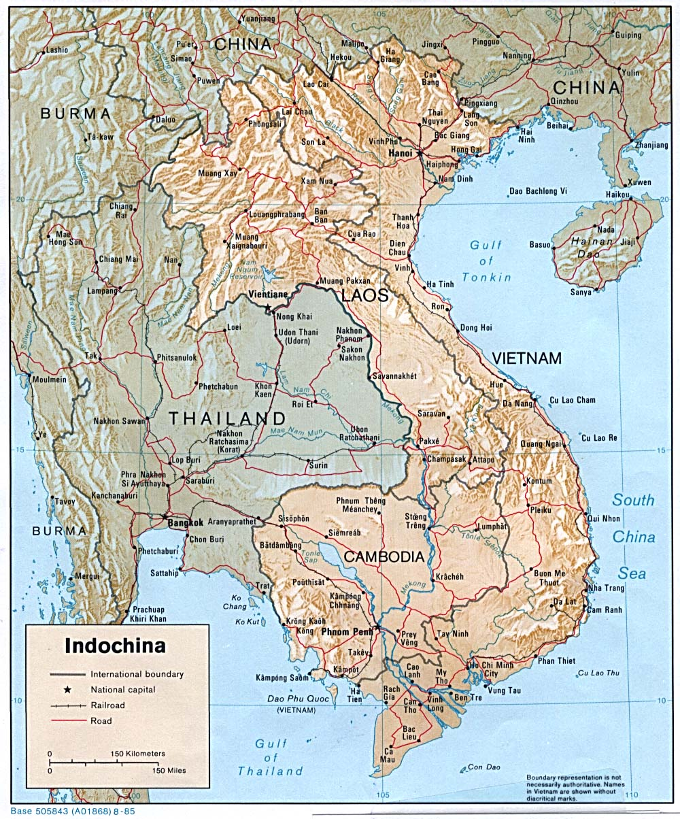
Indochina:
In its broadest sense, Indochina includes most of Southeast Asia; In its strictest sense, it is a political distinction created by France to include its colonial possessions of Vietnam, Laos, and Cambodia (also known as French Indochina).

Slide 5
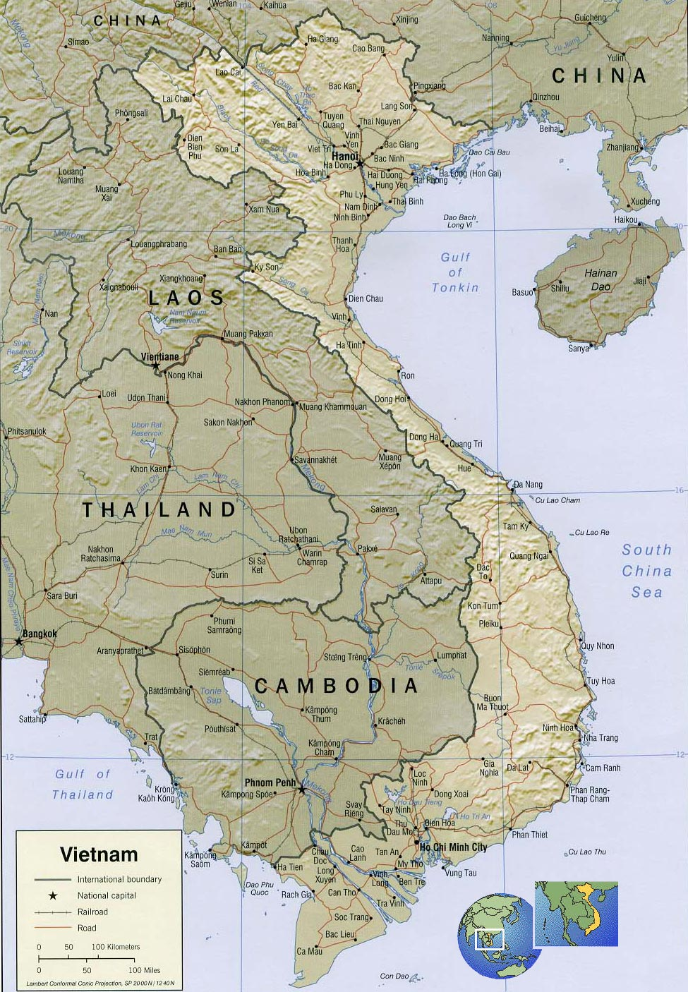
Timeline to War:
1945 (Sept. 2): Ho Chi Minh, in the absence of both Japanese and French imperialists, declares Vietnam an independent nation, with a declaration modeled on our own.
1946: The French under President Charles De Gaulle return to Indochina with full military force, and with support of the U.S.

Slide 6
Question: Why would the U.S. support the re-colonialization of Vietnam in 1946?
Hint: What was going on in Europe at this time (1946)?
The Cold War! The U.S. needed French support for the Marshall Plan and NATO.
The First Indochina War (’46-’54) was fought by Cold War antagonists:
  U.S.S.R. and China supported Vietminh.
  The U.S. supported France.

Slide 7
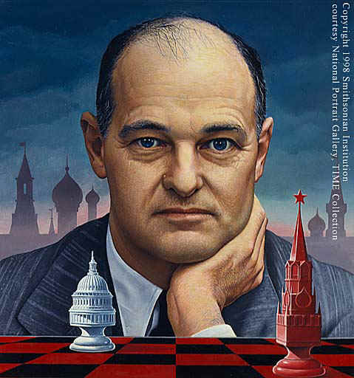
Related Vocabulary:
George F. Kennan
Vietminh:
League for the Independence of Vietnam…nationwide political movement against the French led by Ho Chi Minh.
Containment:
U.S. foreign policy of committing political and economic resources to stop the spread of Communism. (first articulated by George F. Kennan)
Domino Theory:
Belief that Communism had to be stopped or it would spread (like dominoes falling).

Slide 8
Timeline to War:
First Indochina War (1945-1954) ended with the Geneva Accords, which split Vietnam in two at the 17th parallel and recognized independence of Laos and Cambodia.
Critical battle of the First Indochina War was the siege of Dien Bien Phu:
  Vietminh utilized Chinese artillery to defeat the French and essentially end their claims to Indochina.

Slide 10


Timeline to War:
Geneva Accords:
  A Communist government under Ho Chi Minh would control north.
  A national government under Emperor Bao Dai and Prime Minister Ngo Dinh Diem would control south.
  Capitals established in Hanoi and Saigon.
  Elections would be held in 1956 with the aim of unification.

Slide 11
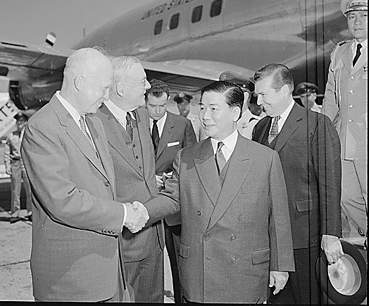
Timeline to War:
1956: Elections not held or supported by U.S., which worked to solidify border and support the Diem regime in the south.
Eisenhower cited the “Domino Theory” as a rationale for not having elections (he feared that Ho Chi Minh would win)
  Comm’s notorious for rigging “free” elections
  Uncle Ho was a popular leader, even among those that did not support Communism.

Slide 12
Relevant Vocabulary:
National Liberation Front:
The “Vietcong.” Communist movement in S. Vietnam; guerrilla fighters loyal to Ho Chi Minh.
NVA:
North Vietnamese Army (loyal to Ho Chi Minh).
ARVN:
Army of the Republic of Vietnam (S. Vietnam) allied w/ the U.S. and French.

Slide 13
Timeline to War:
1956-63: Both Eisenhower and John F. Kennedy increased “advisors” to S. Vietnam.
Kennedy increased levels to about 16,000.
Kennedy ambiguous about U.S. intentions in Vietnam.
Cronkite interviewed Kennedy at Hyannis Port: Find the mixed message
(Cronkite-Kennedy Interview)

Slide 14
Timeline to War:
1964 – Critical Year!
President Johnson dramatically increases U.S. presence in SE Asia after “incidences” in the Gulf of Tonkin.
Johnson was embroiled in an election campaign and wanted to appear tough on Communism.
Tonkin Gulf video
  Tonkin Gulf Resolution amounts to a declaration of war.
  Johnson unleashes “Operation Rolling Thunder – large-scale bombing of N. Vietnam – in Feb. 1965.
1965 also marks the beginning of national prominence for the anti-war movement in the U.S.

Slide 15
Relevant Vocabulary:
Escalation:
An increase in the use of armaments; increase in the scope of a conflict.
Credibility Gap:
The gap between reality and what politicians and governments say about reality. Or, the gap between what L.B.J. was saying about Vietnam and what was actually happening there.

Slide 16
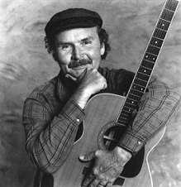
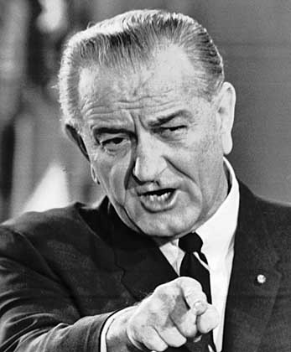
Tom Paxton: Lyndon Johnson Told the Nation 1965
Every night the local gentry,
Sneak out past the sleeping sentry.
They go to join the old VC.
In their nightly little dramas,
They put on their black pajamas,
And come lobbing mortar shells at me.
[Repeat Chorus:]
We go round in helicopters,
Like a bunch of big grasshoppers,
Searching for the Viet Cong in vain.
They left a note that they had gone.
They had to get down to Saigon,
Their government positions to maintain.
[Repeat Chorus:]
Well here I sit in this rice paddy,
Wondering about Big Daddy,
And I know that Lyndon loves me so.
Yet how sadly I remember,
Way back yonder in November,
When he said I'd never have to go.
[Repeat Chorus:]
I got a letter from L. B. J.
It said this is your lucky day.
It's time to put your khaki trousers on.
Though it may seem very queer
We've got no jobs to give you here
So we are sending you to Viet Nam
[Chorus:]
Lyndon Johnson told the nation,
"Have no fear of escalation.
I am trying everyone to please.
Though it isn't really war,
We're sending fifty thousand more,
To help save Viet nam from Viet Namese."
I jumped off the old troop ship,
And sank in mud up to my hips.
I cussed until the captain called me down.
Never mind how hard it's raining,
Think of all the ground we're gaining,
Just don't take one step outside of town.
[Repeat Chorus:]

Slide 17
Bibliography, on-line sources
http://www.mtholyoke.edu/acad/intrel/pentagon/pent12.htm Pentagon Papers related to early Vietnam policy
http://news.bbc.co.uk/onthisday/hi/dates/stories/july/21/newsid_3894000/3894175.stm BBC article from 1954 with provisions and reactions from Eisenhower, Congress to Geneva Accords.
http://www.globalsecurity.org/military/ops/rolling_thunder.htm
http://www.english.uiuc.edu/maps/vietnam/antiwar.html
http://www.time.com/time/magazine/article/0,9171,988162-2,00.html biography of Ho Chi Minh
http://www.history.com/media.do?mediaType=All&searchTerm=Vietnam&action=search&showName=-1&x=7&y=2 History Channel’s index of Vietnam War video.

